Slide 1
Deploy a LAMP Web App on Amazon Lightsail
BY: CHINWUBA CHIDUBEM

Slide 2
OUTLINE
DEFINITION OF AMAZON LIGHTSAIL
OVERVIEW
PROCEDURE

Slide 3
WHAT IS AMAZON LIGHTSAIL?
Amazon Lightsail is a virtual private server (VPS) provider and is the easiest way to get started with AWS for developers, small business, students, and other users who need a solution to build and host their applications on the cloud.
- Amazon web services

Slide 4
OVERVIEW
We would deploy a PHP web application on a LAMP (Linux, Apache, MySQL, PHP) stack using Amazon Lightsail.
Set up a LAMP stack using Amazon Lightsail blueprints.
Deploy a PHP app to the instance.

Slide 5
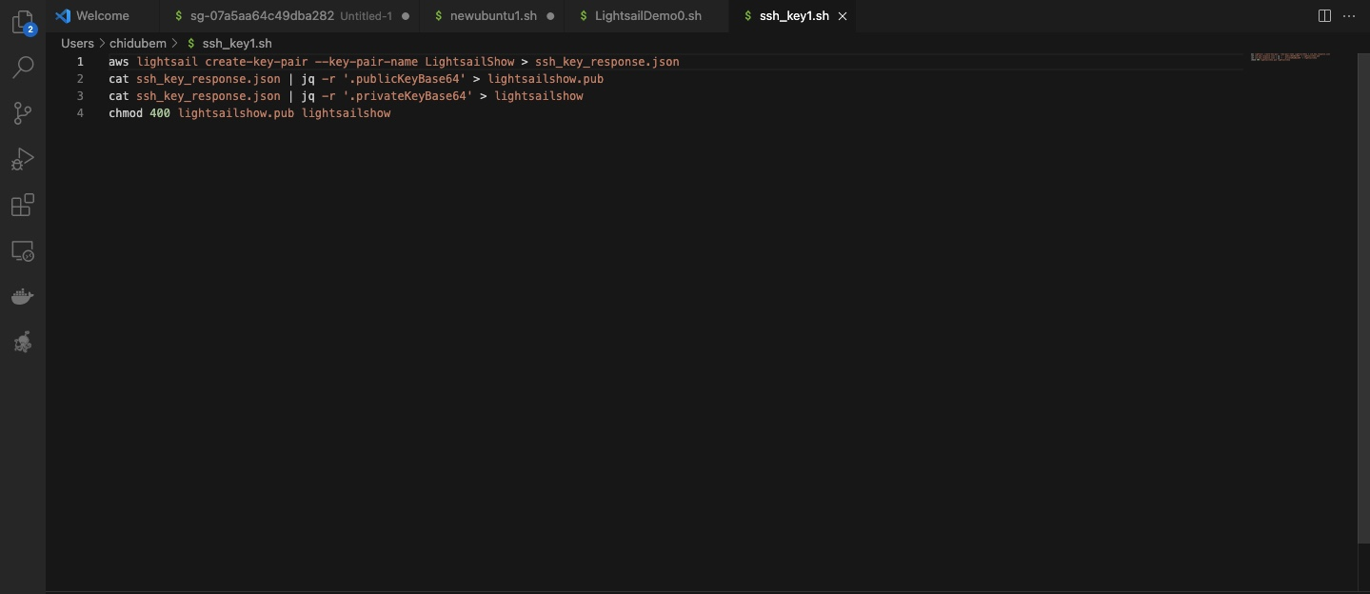
create and ssh key using bash script

Slide 6
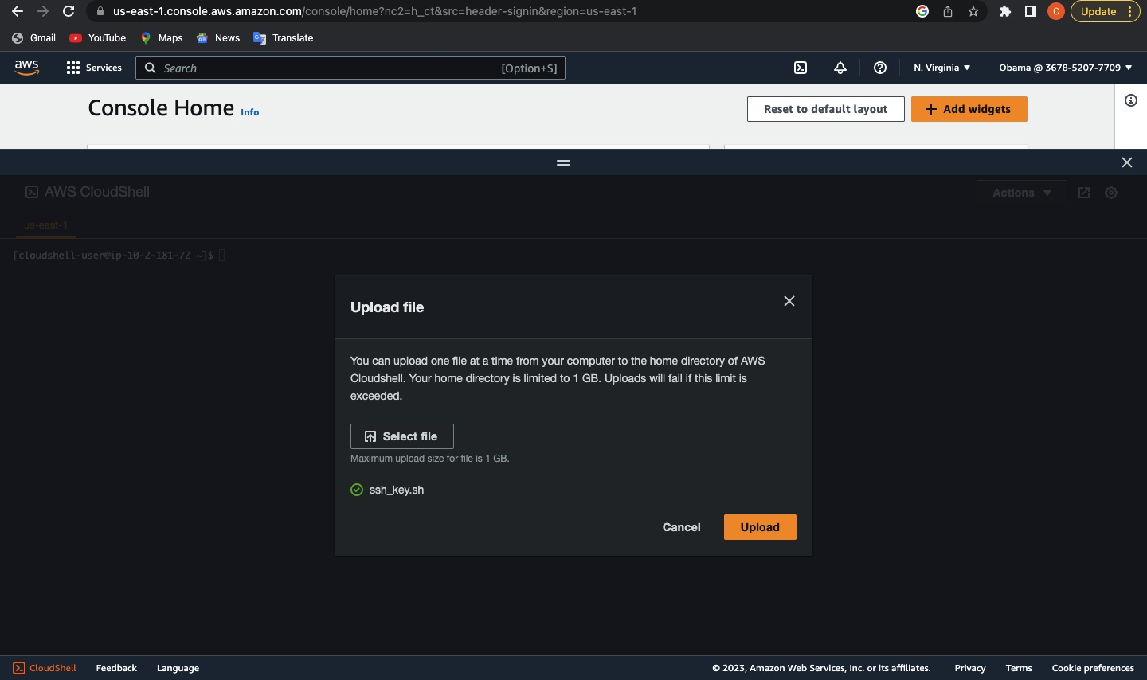
Upload the script to AWS Cloud Shell

Slide 7
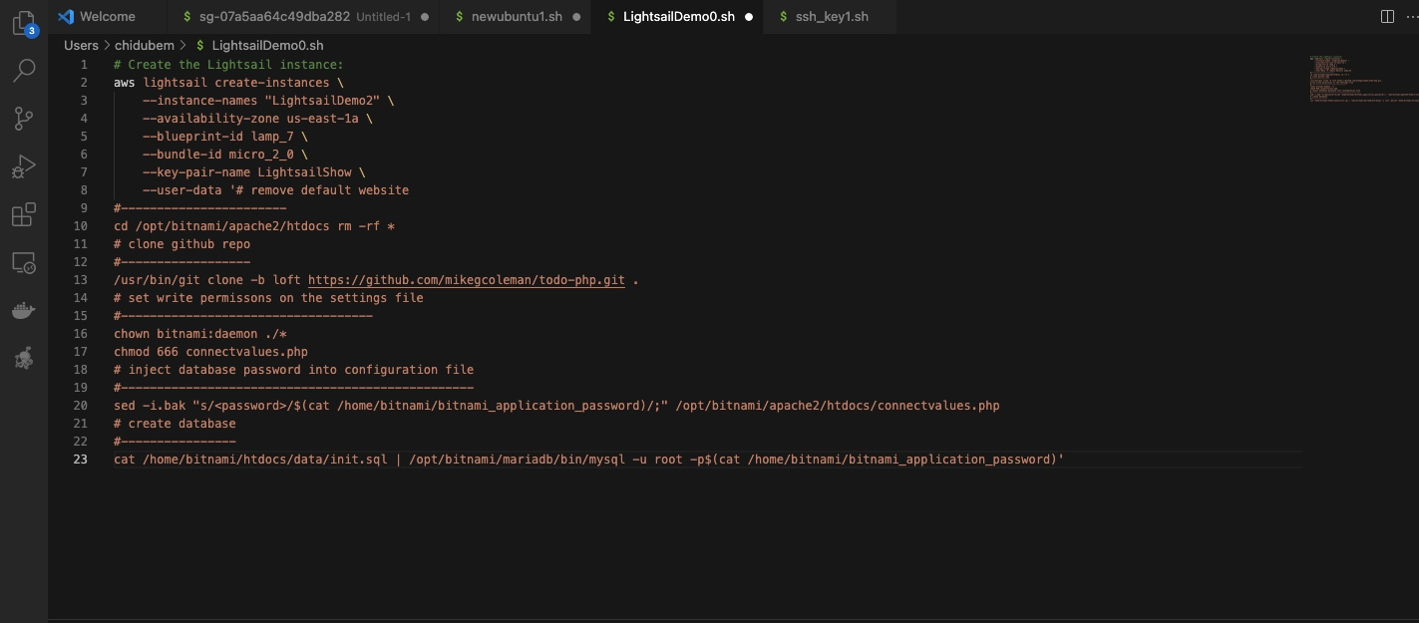
Create Lightsail Instances

Slide 8
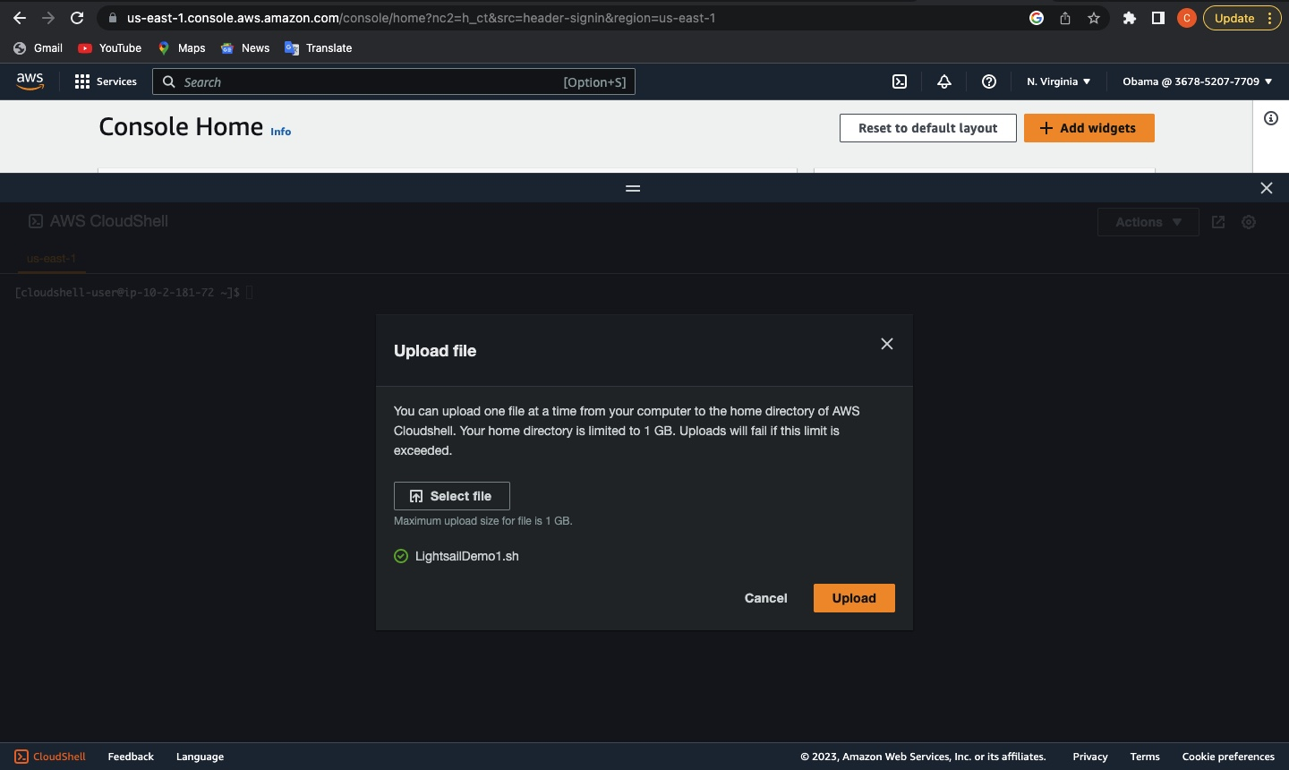
Upload the script to AWS Cloud Shell

Slide 9
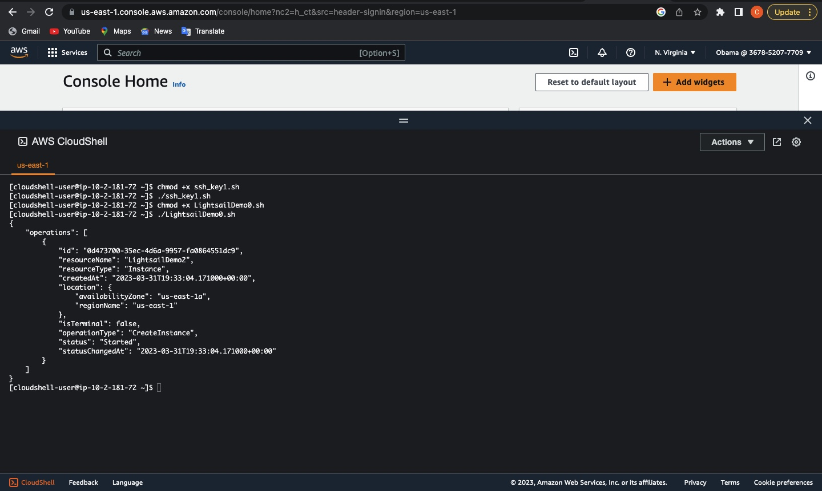
Instances Created

Slide 10
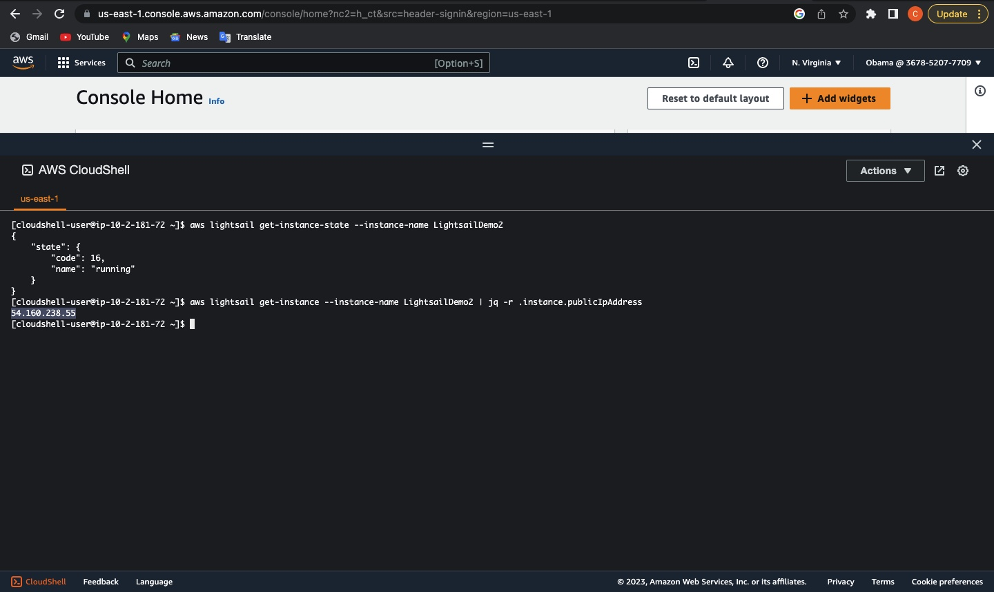
Generate IP Address

Slide 11
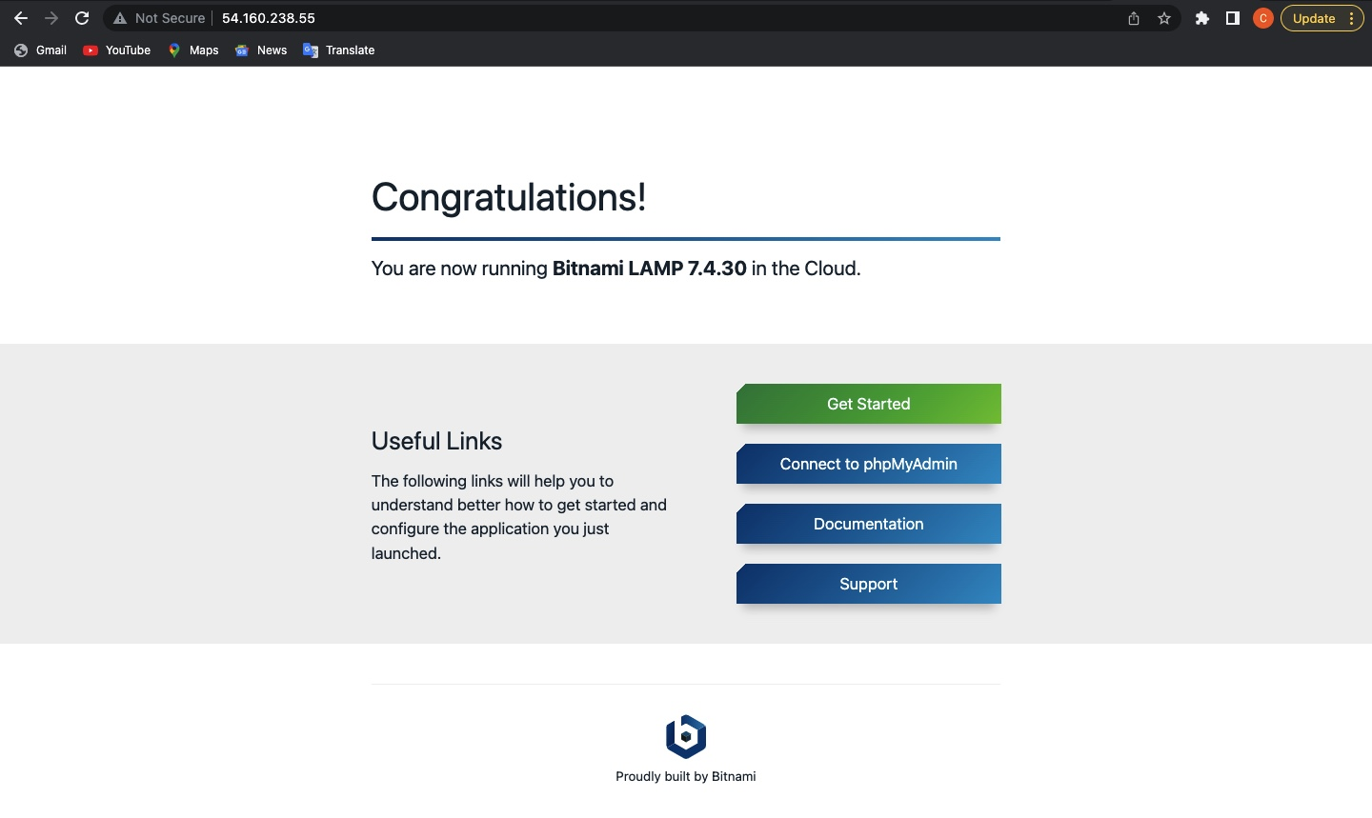
SUCCESSFUL

Slide 12
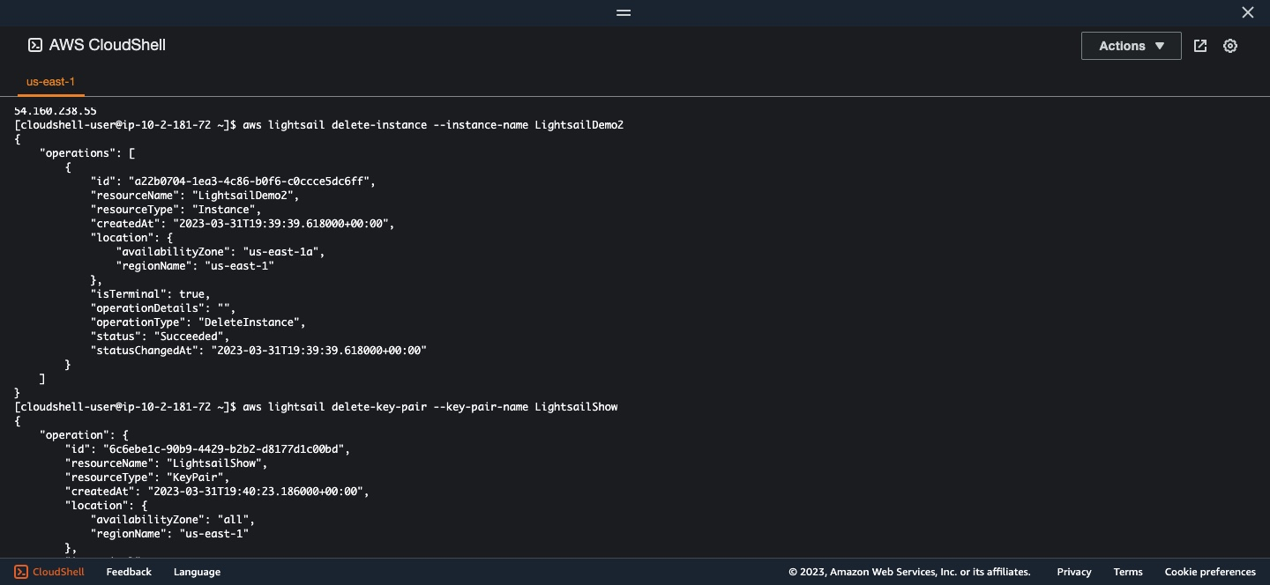
Clean-up Resources

Slide 13
